Slide 1
Natural Variables vs. Renewable Energy
Ignacio Domaica, Jason Amaya,
Gregory Gibbs

Slide 2
Motivation & Summary
Analysis of renewable power generation in random locations in USA.
What effect natural variables have on the output consumption of Renewable energy?

Slide 3
Data
Generation of Latitude and Longitude random sets with numpy python library
Use Citypy to look for nearest city with geo coordinates.
Perform API calls with Openweathermap to access json meteorologic data
Filter to get USA data
Sample size of US Cities (260-290). Around 10% of cities in USA over 500 unhabitants (28.700)
Data cleansing (records skipped, drop NaN values, duplicates, index resetting, etc)
Get elevation with reverse geocoding with google API maps, elevation. Obtain altitude (m)
Represent some maps with markers for USA cities, heat layers for wind and altitude
Get additional data from (https://simplemaps.com/data/us-cities) like
state_id
State
timezone
Get additional data from (https://www.currentresults.com/Weather/US/weather-averages-index.php) like
Sun Radiation (h)
Precip_inch
Precip_mm
Get additional data from (https://www.currentresults.com/Weather/US/weather-averages-index.php) like
mean elevation feet
mean elevation meters
Get additional data from (https://www.currentresults.com/Weather/US/weather-averages-index.php) like
Hydro cons (BTU)
Solar cons (BTU)
Wind cons (BTU)

Slide 4
Data
Generation of Latitude and Longitude random sets with numpy python library
Use Citypy to look for nearest city with geo coordinates.
Perform API calls with Openweathermap to access json meteorologic data
Filter to get USA data
Sample size of US Cities (260-290). Around 10% of cities in USA over 500 unhabitants (28.700)
Get elevation with reverse geocoding with google API maps, elevation. Obtain altitude (m)
Represent some maps with markers for USA cities, heat layers for wind and altitude
Get additional data from (https://simplemaps.com/data/us-cities) like
state_id
State
timezone
Get additional data from (https://www.currentresults.com/Weather/US/weather-averages-index.php) like
Sun Radiation (h)
Precip_inch
Precip_mm
Get additional data from Census Bureau Tables (https://www.census.gov/data/tables.html) (https://bit.ly/3fiPEcJ) like
mean elevation feet
mean elevation meters
Get additional data from (https://www.currentresults.com/Weather/US/weather-averages-index.php) like
Hydro cons (BTU)
Solar cons (BTU)
Wind cons (BTU)

Slide 5
Data Sources
Latitude and Longitude random sets with numpy python library
Citypy to look for nearest city with geo coordinates.
Openweathermap. https://openweathermap.org/ for API, json with meteorological data
Google for plotting maps and diverse data
Reverse geolocation to get altitude https://maps.googleapis.com/maps/api/elevation/json
https://simplemaps.com/data/us-cities
Census Bureau Tables https://www.census.gov/data/tables.html https://bit.ly/3fiPEcJ
https://www.currentresults.com/Weather/US/weather-averages-index.php averages are based on data collected by weather stations throughout each state from 1971 and provided by the NOAA National Climatic Data Center.
US department of Agriculture. https://wcc.sc.egov.usda.gov/nwcc/site?sitenum=2168
CORGIS https://corgis-edu.github.io/corgis/csv/
CORGIS https://corgis-edu.github.io/corgis/csv/weather/
https://windexchange.energy.gov/maps-data
https://www.nrel.gov/research/data-tools.html
https://power.larc.nasa.gov/data-access-viewer/

Slide 6
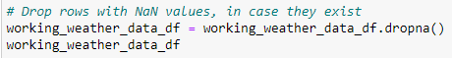
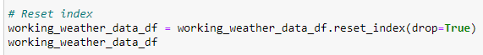
Data Cleanup
Most typical procedures were:
Drop rows with NaN values
Eliminate duplicated values. e.g
Reset indexes
Eliminate 1st column of a Dataframe
Careful saving or reading .csv.
There are two ways to handle the situation where we do not want the index to be stored in csv file.
https://stackoverflow.com/questions/20845213/how-to-avoid-python-pandas-creating-an-index-in-a-saved-csv

Slide 7
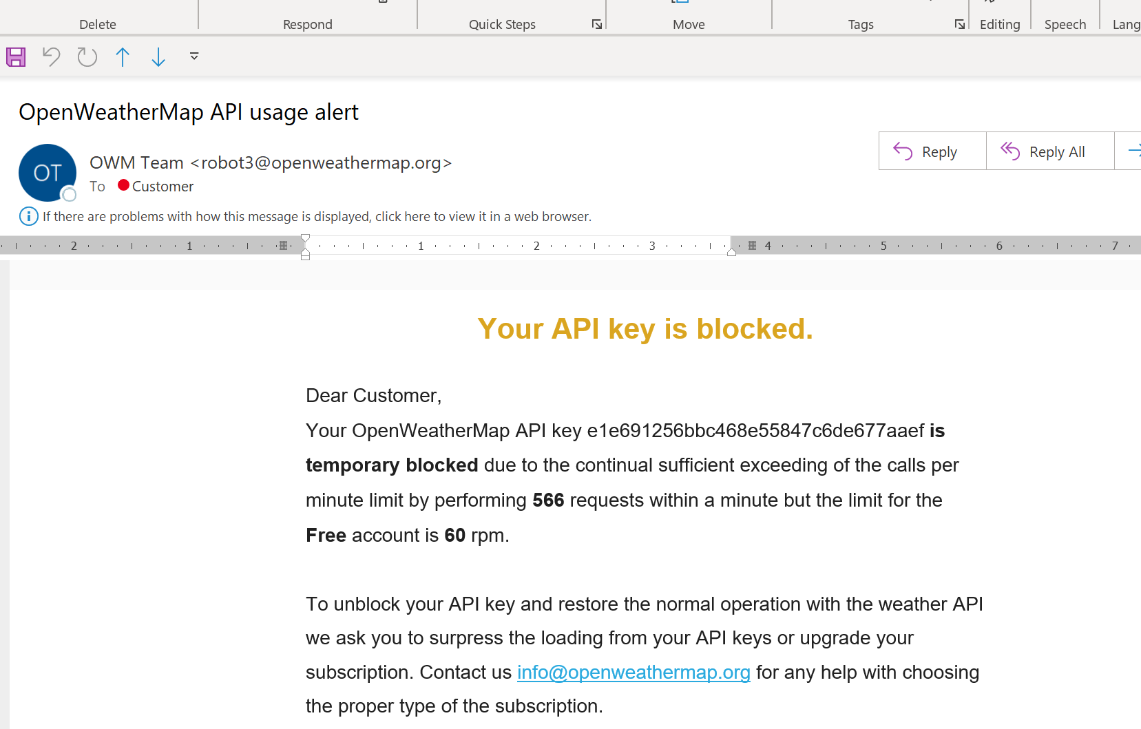
Data Cleanup
Save your dataframes data if possible in .csv format, so you avoid repeatedly API accesses
Careful saving or reading .csv.
There are two ways to handle the situation where we do not want the index to be stored in csv file.
https://stackoverflow.com/questions/20845213/how-to-avoid-python-pandas-creating-an-index-in-a-saved-csv

Slide 8
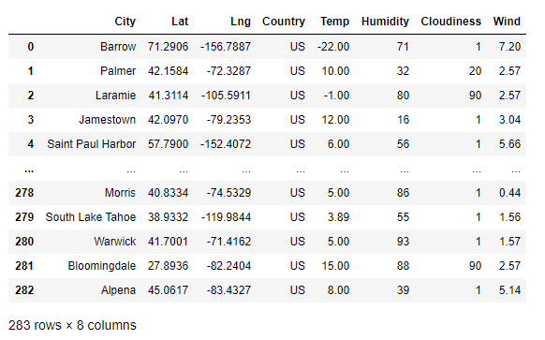
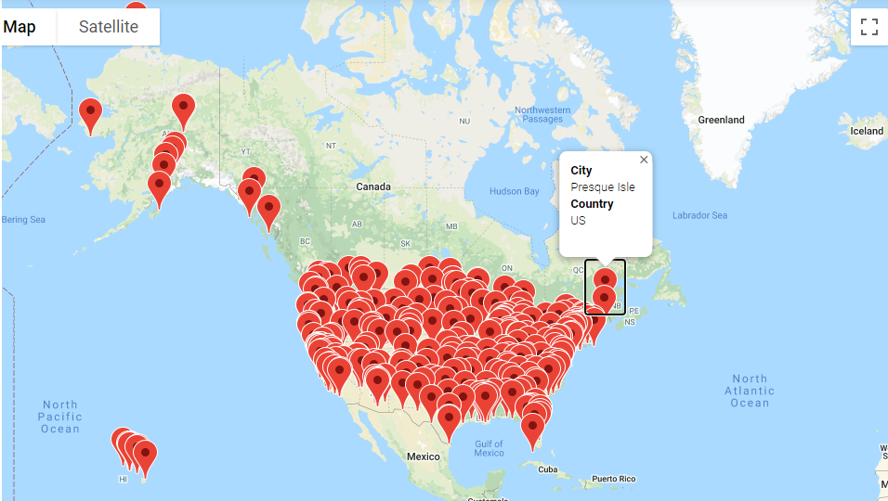
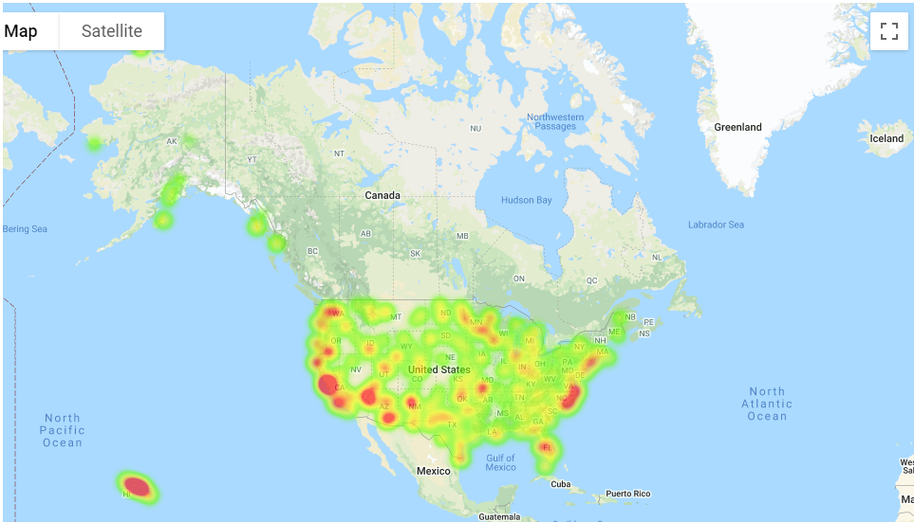
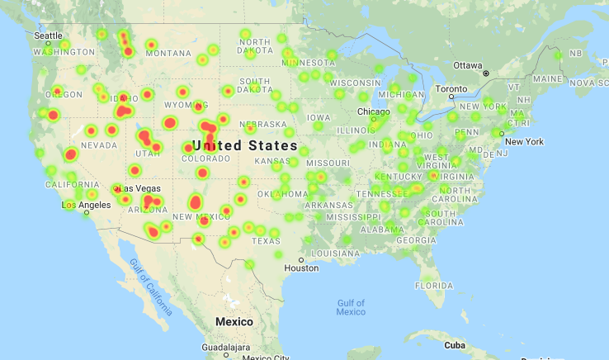
Data Extraction
Wind
Altitude

Slide 9
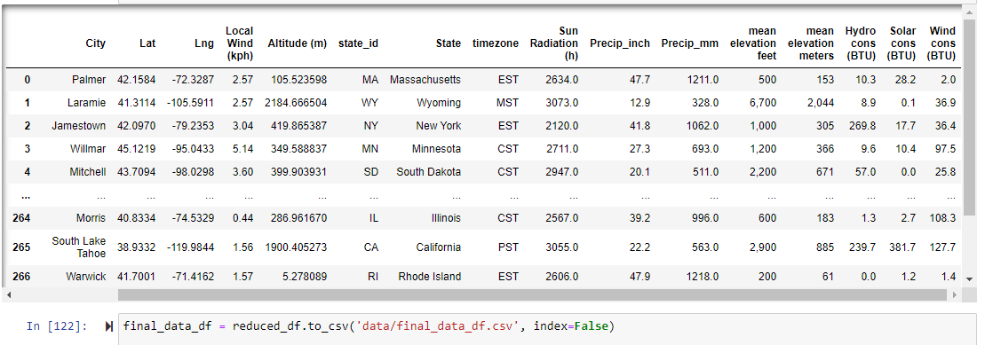
final_data_df

Slide 10
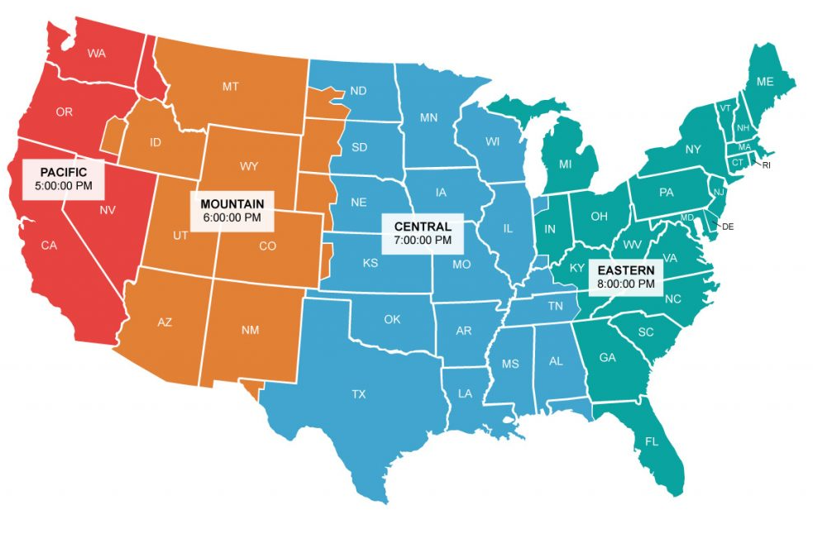
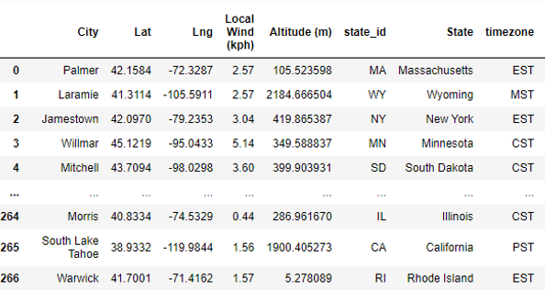
Chi-square. Ingredients

Slide 11
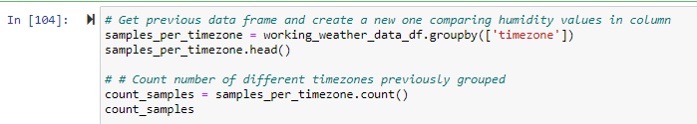
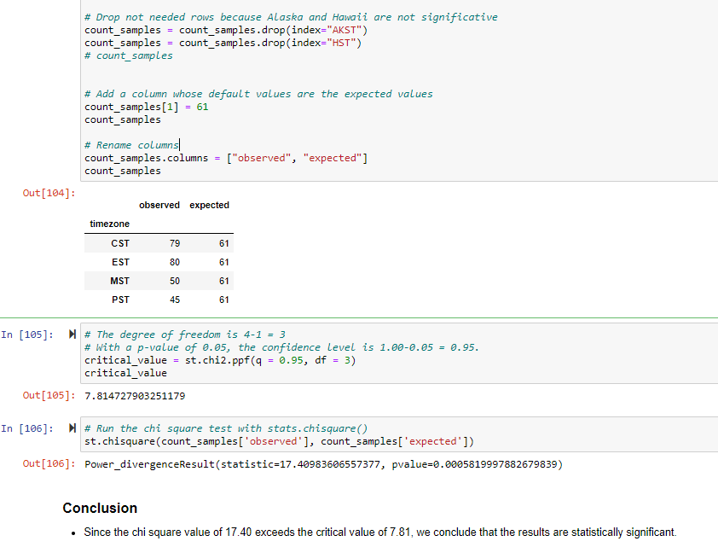
Chi-square. Results

Slide 12
Data Analysis
Matplotlib/Linear Regression?
Solar Radiation vs. Renewable
Avg. Wind Velocity vs. Renewable ?
Avg. Humidity vs. Renewable?
Elevation vs. Renewable ?

Slide 13
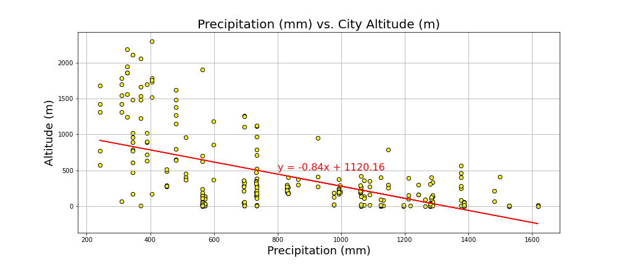
Precipitation vs Altitude. Correlation and regression
The correlation between both factors is: -0.58
Typically closest to 1 or -1. Bigger than 0.75 or smaller than -0.75

Slide 14
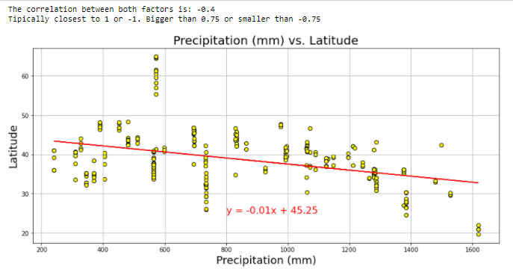
Precipitation vs Latitude. Correlation and regression

Slide 15
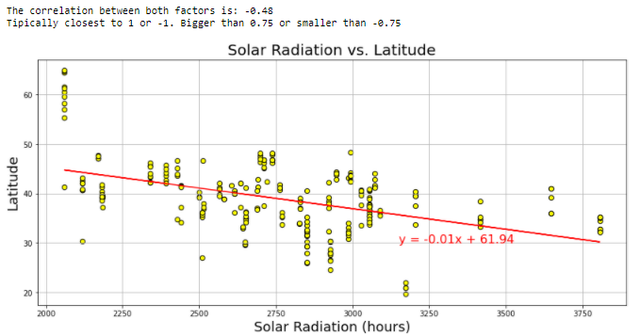
Solar Radiation vs Latitude Plot. Correlation. Regression

Slide 16
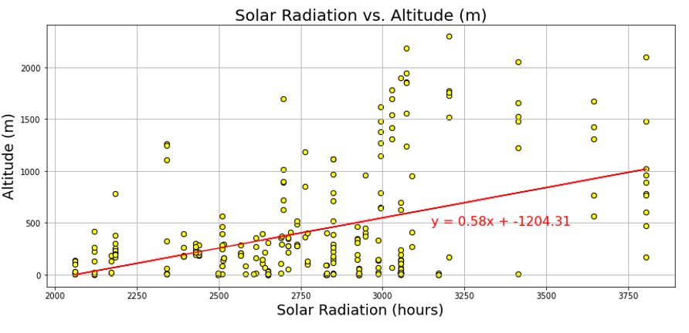
Solar Radiation vs Altitude Plot. Correlation. Regression
The correlation between both factors is: 0.44 Typically closest to 1 or -1.
Bigger than 0.75 or smaller than -0.75

Slide 17
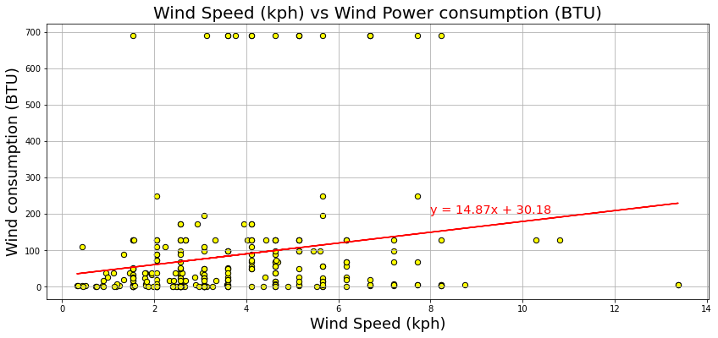
Wind Speed (kph) vs Wind Power consumption Plot. Correlation. Regression
The correlation between both factors is: 0.19
Typically closest to 1 or -1. Bigger than 0.75 or smaller than -0.75

Slide 18
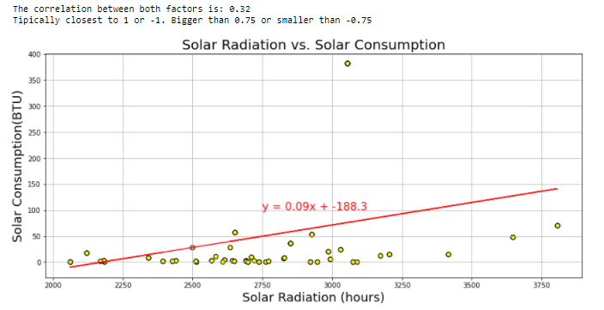
Solar Radiation vs Solar consumption. Correlation. Regression

Slide 19
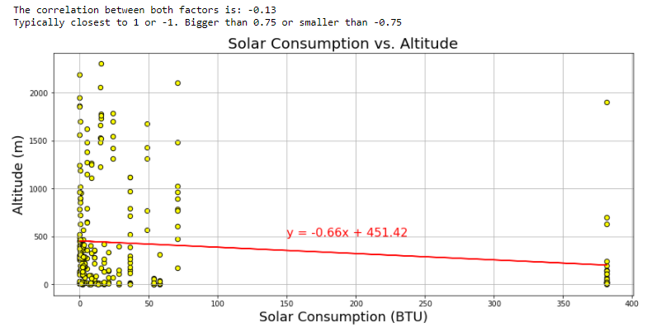
Solar power consumption vs Altitude. Correlation. Regression

Slide 20
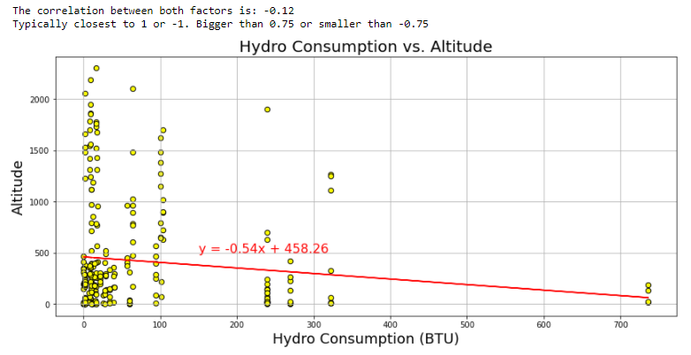
Hydropower consumption vs Altitude. Correlation. Regression

Slide 21
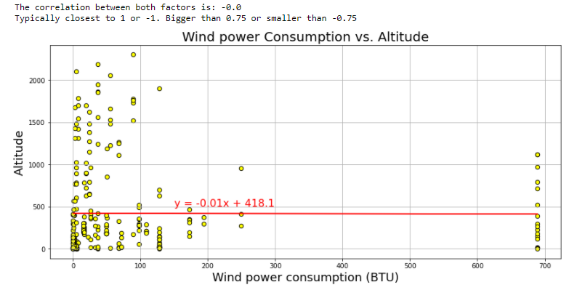
Eolic/Wind power consumption vs Altitude. Correlation. Regression

Slide 22
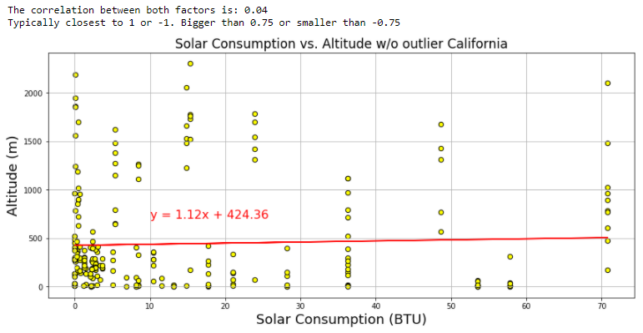
Check consumption eliminating outliers. Solar / California

Slide 23
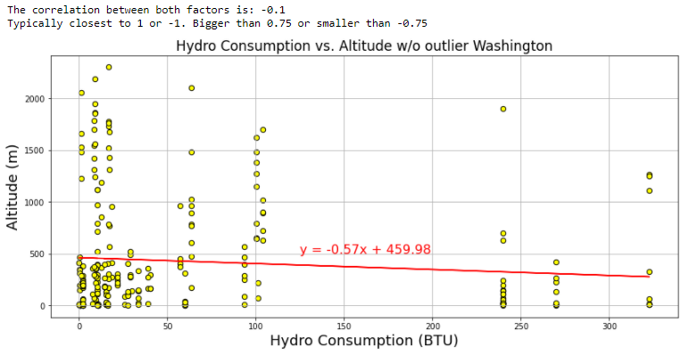
Check consumption eliminating outliers. Hydro / Washington

Slide 24
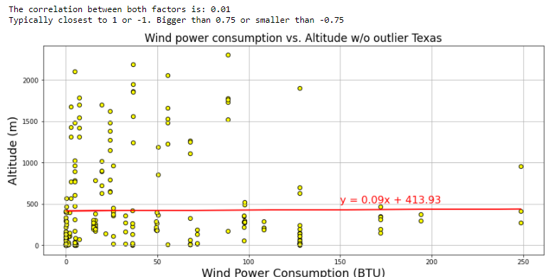
Check consumption eliminating outliers. Wind / Texas

Slide 25
Discussion
Findings:
How close to hypothesis?

Slide 26
Post Mortem
Difficulties?
What would we do if given more time?

Slide 27
BACK UP

Slide 28
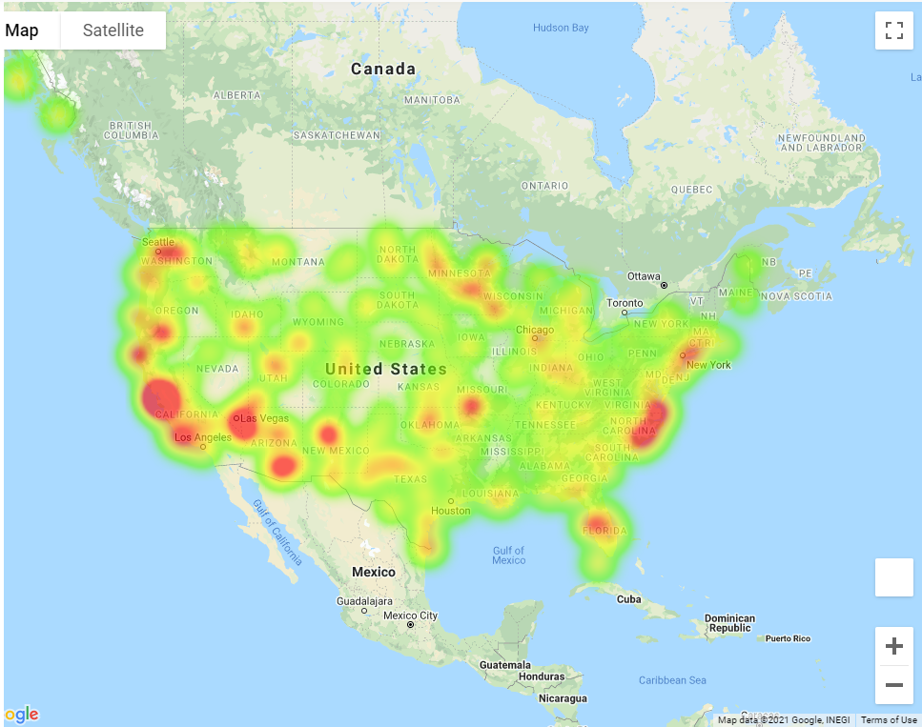

Slide 29
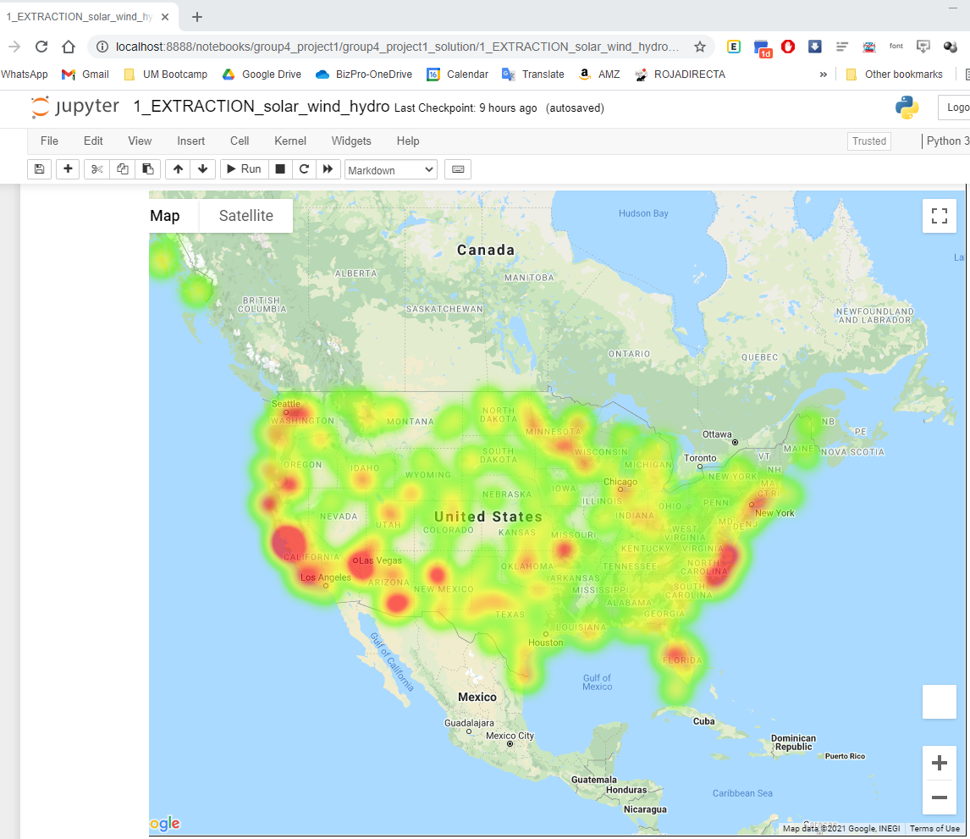

Slide 30
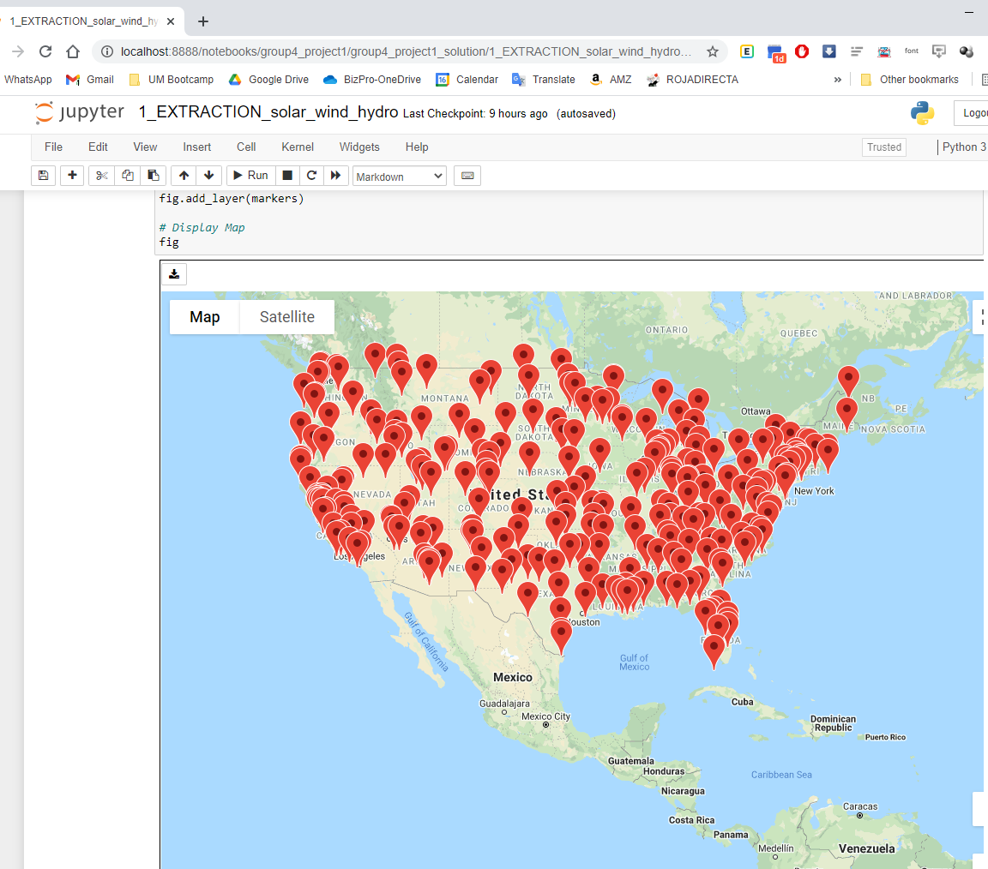

Slide 31
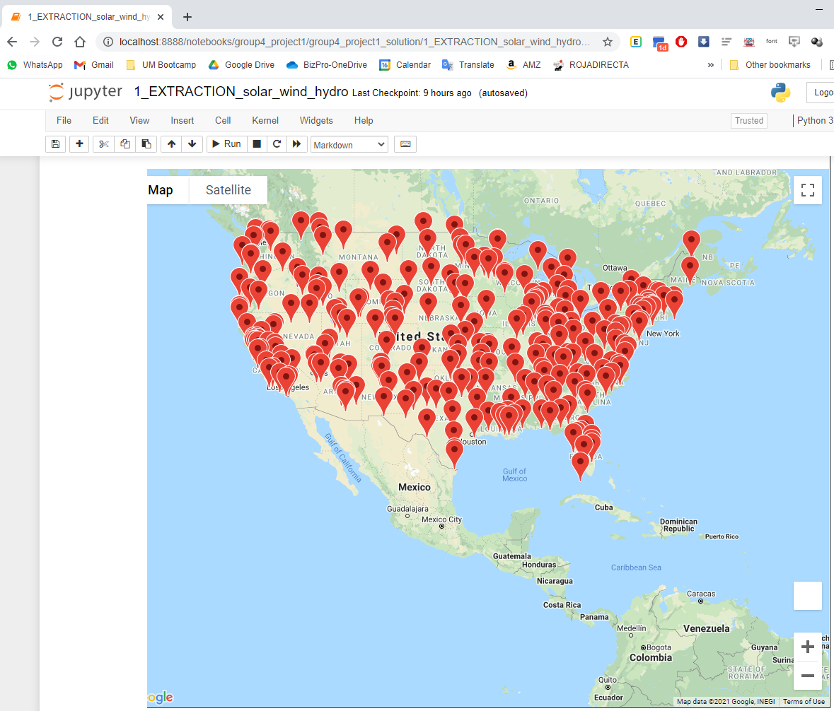

Slide 32
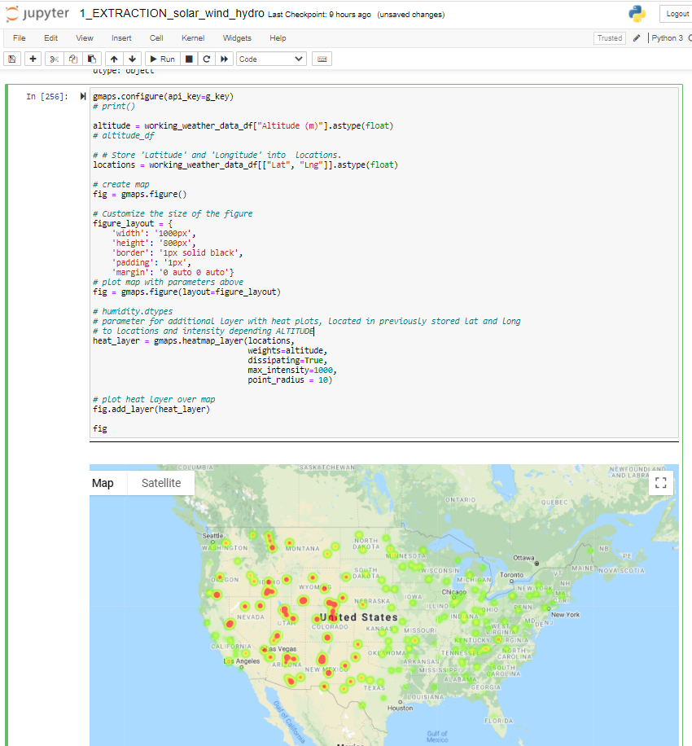

Slide 33
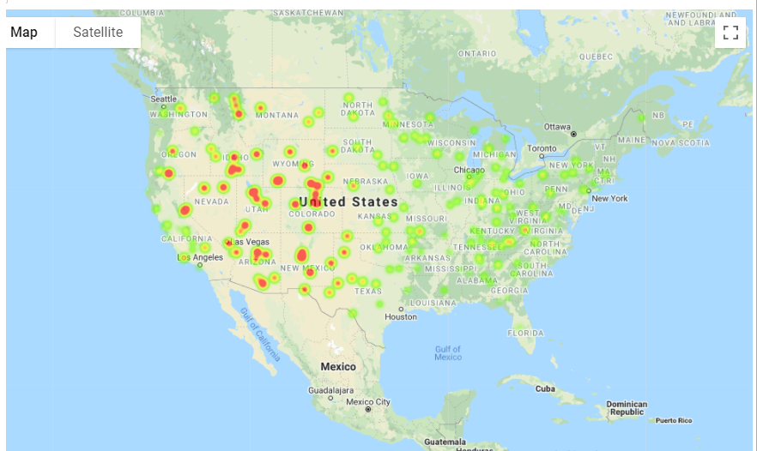

Slide 35
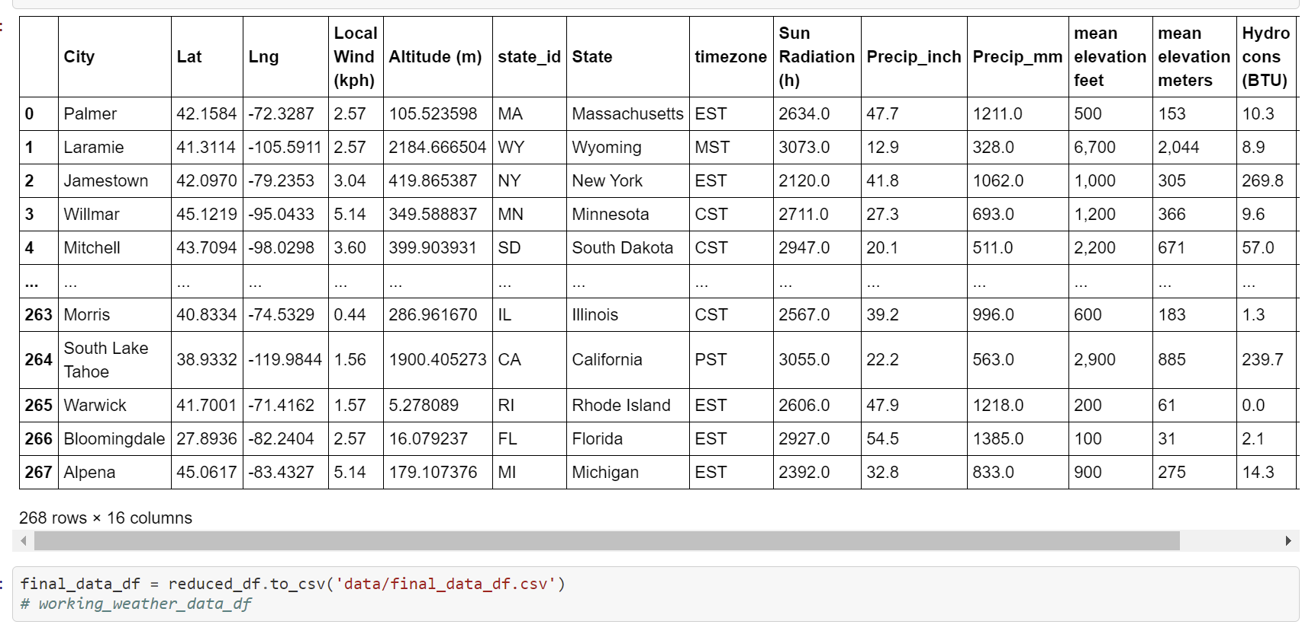

Slide 36
